Slide 1

Impact of Social Media on student’s Mental Health
By - DEBIRUPA CHAKRABORTY
Student Code – AF05149775

Slide 2
Introduction & Context
The Digital Shift
As smartphones and social networks cement their place in student life, educators and psychologists are actively tracking the impact. Screen time is no longer just digital interaction; it represents a primary stressor and safety factor in student academic journeys.
Core Objectives
This presentation utilizes real Power BI dashboard records of 5,000 students to trace correlations between screen-time volume, chosen platforms, sleep deficits, academic tiering, and subjective mental health ratings.

Slide 3
CONTENT
Project overview
Visualizations
Student Social Media Analysis
Dataset Diamensions
Academics vs. Intention
Dashboard Filters
The Sleep Deficit Connection
Strategic Action Items
KPI Cards

Slide 4
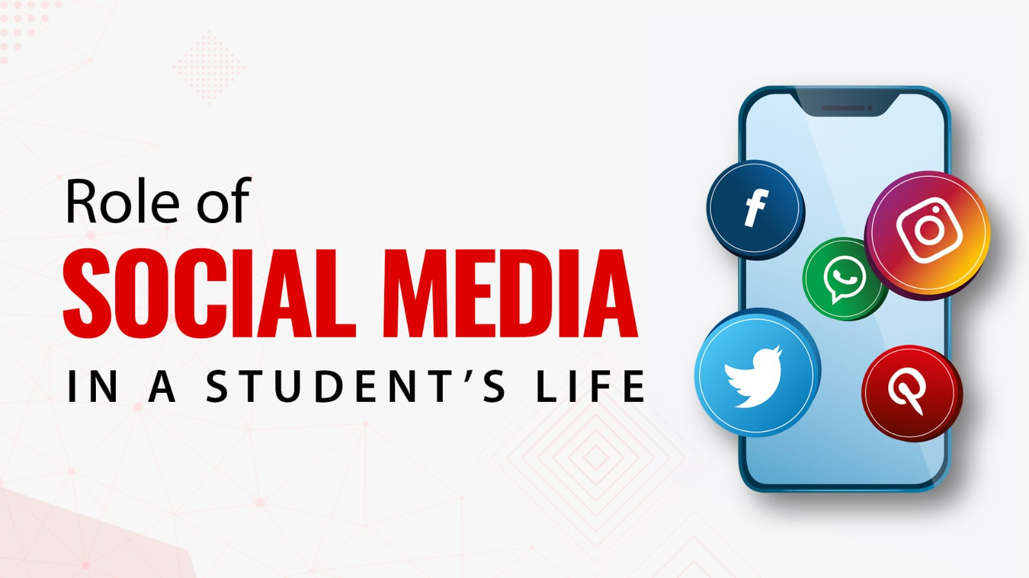
Project Overview
Analyse relationships between student social media usage , academic performance , stress levels and Mental health indicators.

Slide 5
Dataset Diamensions
Key Field Observed :
Gender
Academic Level
Stress Level
Purpose of Social Media usages
Related Student metrics.

Slide 6

Dashboard Filters
Interactive slicers for Gender, Academic Level, Stress Level, and Purpose of Social media Use.

Slide 7
KPI Cards
Dashboard includes summary KPI Cards displaying key Student and mental health metrics.

Slide 8
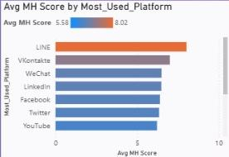
Visualizations
USAGES HOURS BY PLATFORM

Slide 9
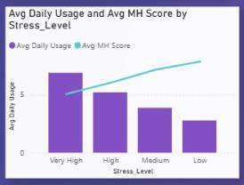
AVERAGE DAILY USAGE AND AVERAGE MH SCORE BU STRESS LEVEL

Slide 10
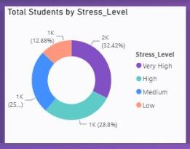
STUDENTS BY STRESS LEVEL

Slide 11
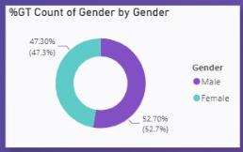
% GT COUNT OF GENDER BY GENDER

Slide 12
Academics vs. Intention
Academic Cohort Wellbeing
High Schoolers Report Lowest Scores
High schoolers sit at the lowest average rating (5.86) compared to Undergraduates (6.24) and Graduate-level students (6.39). This highlights vulnerability during early developmental stages.
Intention/Purpose Impact
Entertainment vs. Purpose
Pure entertainment-driven usage correlates with lower mental health outcomes (6.12). Networking (6.38) and educationally-aligned screen habits (6.35) offer protective buffers.

Slide 13
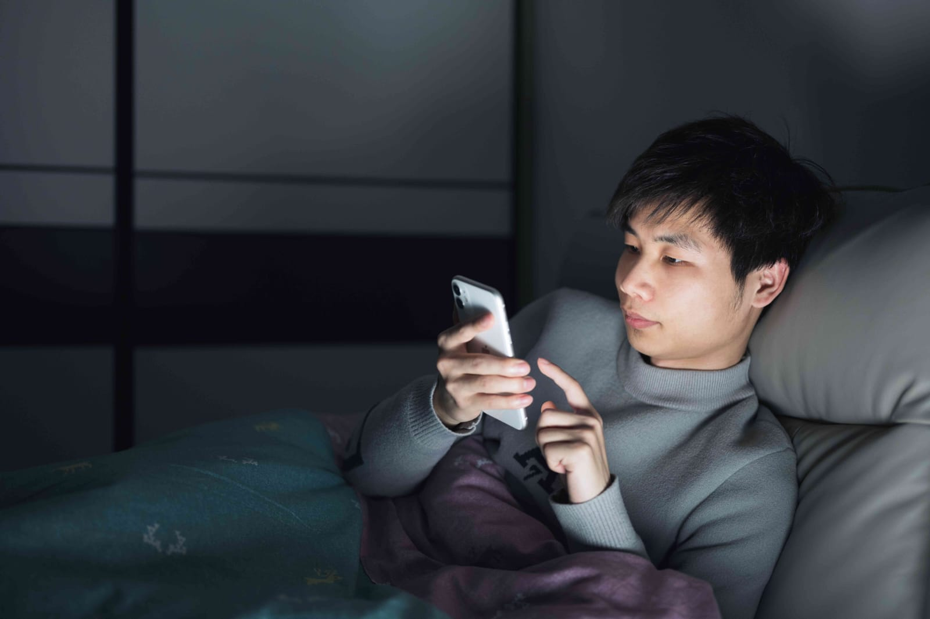
The Sleep Deficit Connection
Target: Restless Sleeping Habits
As screen time climbs, sleep quality drops dramatically. Students logging over 6 hours of daily social media use average fewer than 6 hours of sleep, directly compounding academic stress.
Late-night scrolling habits, blue light exposure, and constant notifications are core disruptors of sleep hygiene across the cohort.

Slide 14
Strategic Action Items
Target High-Risk Cohorts: High School and Highly Stressed students require targeted educational outreach and early mental health support.
Shift Usage Purpose: Encourage shifts from passive entertainment scrolling toward constructive networking or active learning.
Address Sleep Hygiene: Implement campaigns targeting night-time screen use to reverse chronic sleep deficits below 6 hours.

Slide 15
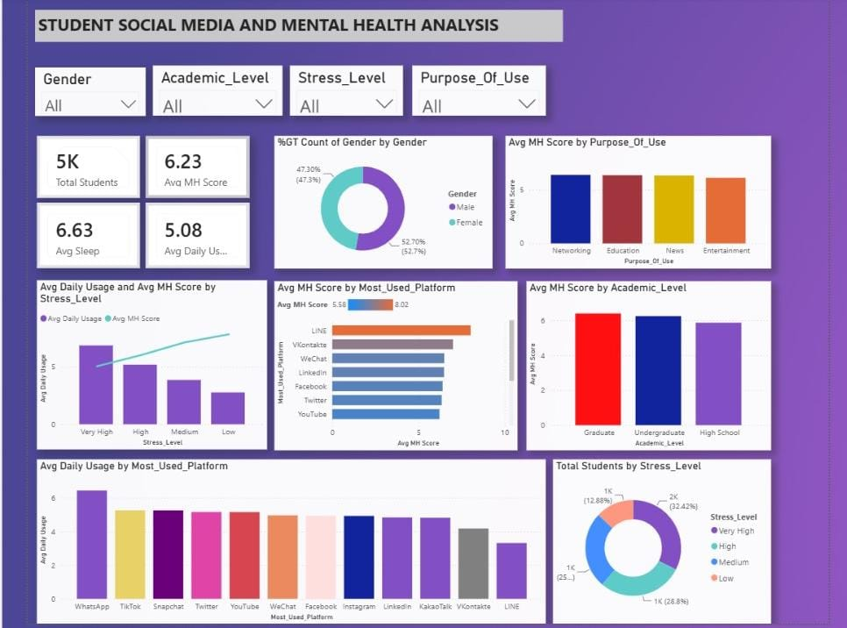
Dashboard

Slide 16
Thank You

